Slide 1
Capital Improvement Program
FY 2013/14
Presentation to the
Fort Ord Reuse Authority
Board of Directors
May 10, 2013

Slide 2
Capital Improvement Remaining Obligations
Mitigations funded by CFD fees | FY 13/14 Amount
Transportation/Transit | $115,711,996
Water Augmentation (CEQA) | $23,452,781
Water Augmentation (voluntary) | $21,655,302
Storm Drainage System (3 outfalls removed) | $0/Obligation met
Habitat Management | $33,437,419
Fire Rolling Stock | $116,000
Other Costs & Contingencies | $49,000,621
Basewide obligations funded by Land Sales | FY 13/14 Amount
Building Removal Program | $6,200,000

Slide 3
Transportation/Transit
Previous Board direction elevated Eastside Parkway funding to higher priority
  Eastside Parkway connectivity dependent on completion of Inter-Garrison Road and Eucalyptus Road (and a portion of Gigling Road)
  Unlikely to collect $ amount required for construction in FY 13-14
  Construction cannot occur until munitions cleanup work is complete and CEQA performed, anticipated in 2015/16
Current funding priority is given to:
  Project 2b (Davis Road Bridge south of Blanco) - A reimbursement agreement with Monterey County is in place; funds are being used as a grant local match
  Project FO14 (South Boundary Road Upgrade) - Project cost is within grant range; projected to collect enough fees for a local match

Slide 4
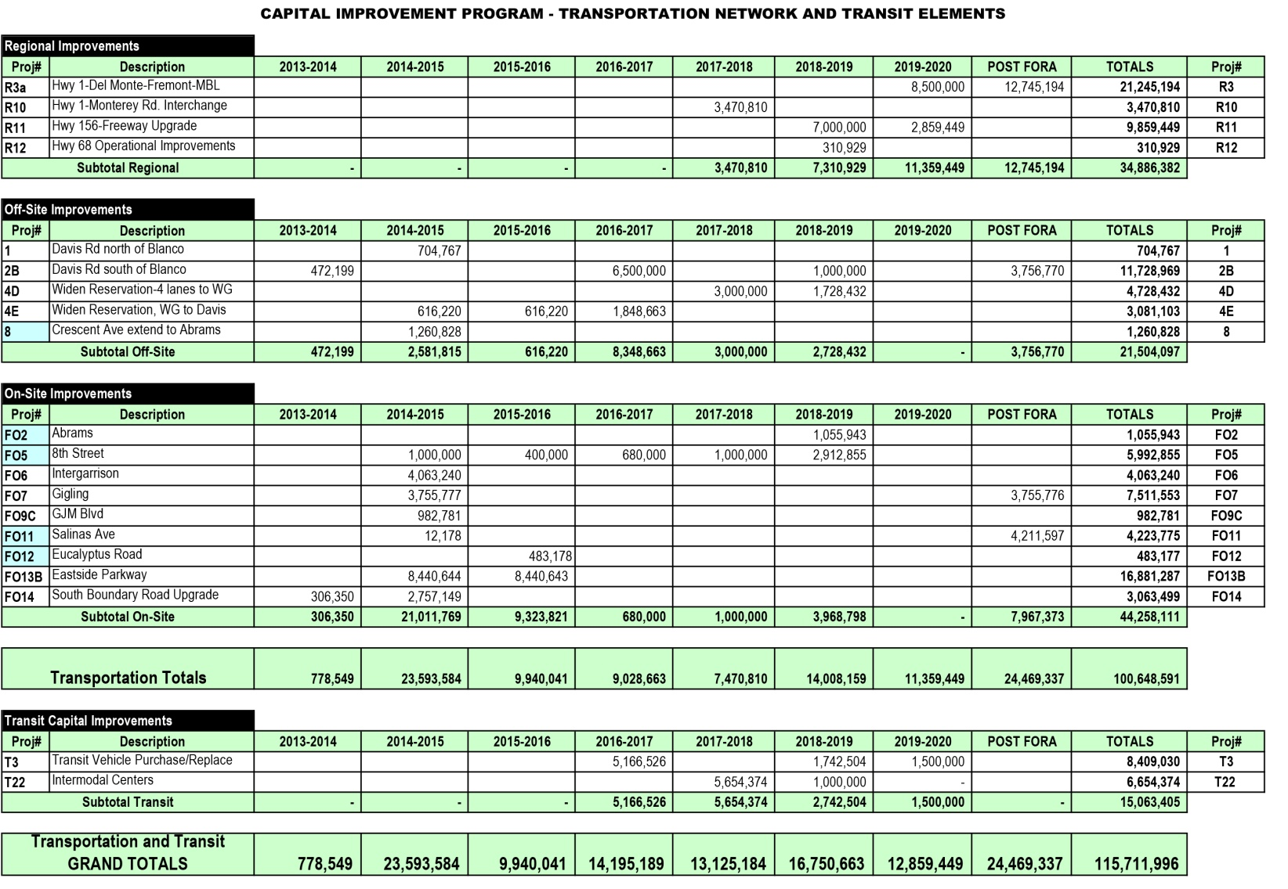

Slide 5
Water Augmentation
$23,452,784 CEQA mitigation included in BRP
$21,655,302 FORA Board-approved (voluntary) contribution to buy down MCWD connection fees
  FORA/MCWD staff, Administrative/Water Wastewater Oversight Committees reviewed MCWD rate study
  FY 05/06 CIP adopted, FORA Board approved $17M contribution to “buy down” connection fee
  Original amount indexed to current amount through FY 11/12
  MCWD scheduled to complete new rate study by September 2013

Slide 6
Habitat Management
25% of development fee collected builds endowment
  $39.5M total endowment; $4.9M collected to date; $33.4M remains to be collected
  $19.1M contingency, final amount will be based on actual payout rate allowed by the CA Dept. of Fish & Wildlife (CDFW)
Ongoing negotiations with the USFWS and CDFW
Total HCP endowment to produce $1.7M per year.

Slide 7
Other Costs & Contingencies
FY 10/11 CIP carried $124,599,124 for other costs & contingencies – Phase I review resulted in reductions
Caretaker Costs
  $12.2M Property Management and Caretaker Costs - during CIP Phase I Review, LUJs expressed concern over accepting property without resources to manage them
  During Phase II Review, this obligation was revised to $660,000 annually based on past caretaker costs (Army-Jurisdictions)
  $660,000 annual caretaker cost is deducted from land sales revenue
Additional CIP Costs
  $16.9M - potential and unknown additional basewide expenditures not included in current cost estimates for transportation projects (i.e. contract change orders to ESCA, project changes, etc.)
Habitat Management
  $19.1M - dependent on payout rate allowed by CDFW
Additional Utilities & Storm Drainage
  $3.5M - removal of retention ponds and restoration of the dunes, reporting requirements, potential utility relocation costs due to CIP projects
Other Costs (Debt Service)
  $9.4M – Loan principal and interest and match for General Jim Moore Blvd.

Slide 8
Building Removal Program
Funded from land sale revenue and/or credited against land sale valuation
  2005 MOA with the City of Marina - $46M in building removal costs within the Dunes on Monterey project area
  2006 MOA with Monterey County - $2.1M in building removal costs within the East Garrison project area
FORA’s remaining building removal obligations include the former stockade (±$2.2M) and specific, selected buildings in the City of Seaside “Surplus II” area (±$4M)

